Slide 1
Part 3

Slide 2
SORCERERS
“An enchanter with drugs” –Robert Young
(Analytical Concordance To The Bible)

Slide 3
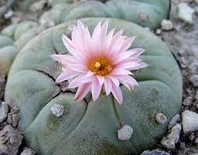
SORCERY TODAY?
The Native American Church & Peyote
Substance Abuse/Drug Use

Slide 4
IDOLATERS

Slide 5
MURDER
↓
LIFE
SEXUALLY IMMORALITY
↓
BODY
SORCERY
↓
MIND
IDOLATRY
↓
VIEW OF GOD
Prohibition for the Preservation
Exod. 20:3-5
Col. 3:5

Slide 6
ALL LIARS

Slide 7

Matthew 15:1; Luke 6:45
ALL LIARS
“In transgressing and lying against the LORD, And departing from our God, Speaking oppression and revolt, Conceiving and uttering from the heart words of falsehood”
(Isa. 59:13, NKJV)

Slide 8
ALL LIARS
APPLICATIONS
He who adds to God’s word
He who “knows” but does not “obey”
He who “loves God” but “hates his brother”
He who denies the Messiah

Slide 9
REPENT
Revelation 9:20, 21
BE BAPTIZED
Acts 2:38/Rev. 1:5
AVOID

Slide 10
8 in flaming fire taking vengeance on those who do not know God, and on those who do not obey the gospel of our Lord Jesus Christ.
9 These shall be punished with everlasting destruction from the presence of the Lord and from the glory of His power,
10 when He comes, in that Day, to be glorified in His saints and to be admired among all those who believe, because our testimony among you was believed.
2 THESSALONIANS 1:8-10

